Slide 1


Slide 2



Slide 3

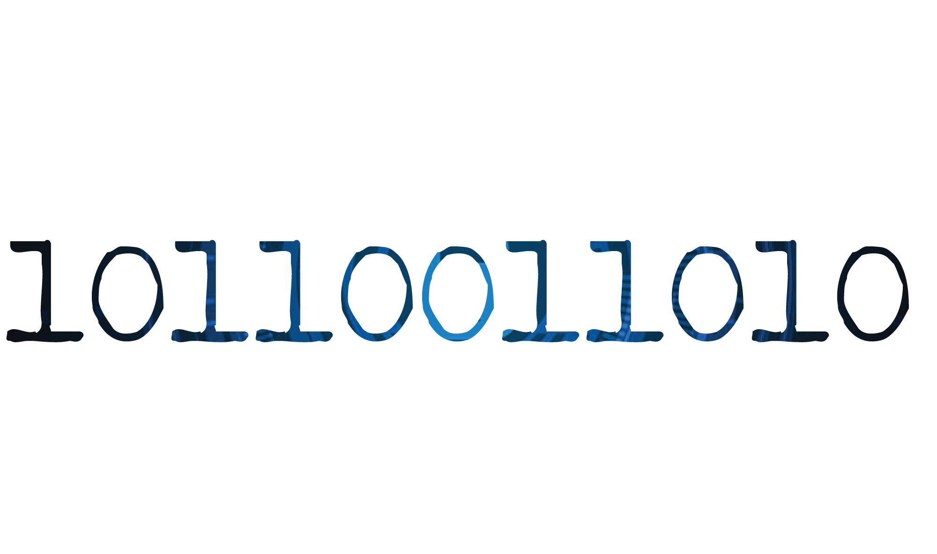

Slide 5
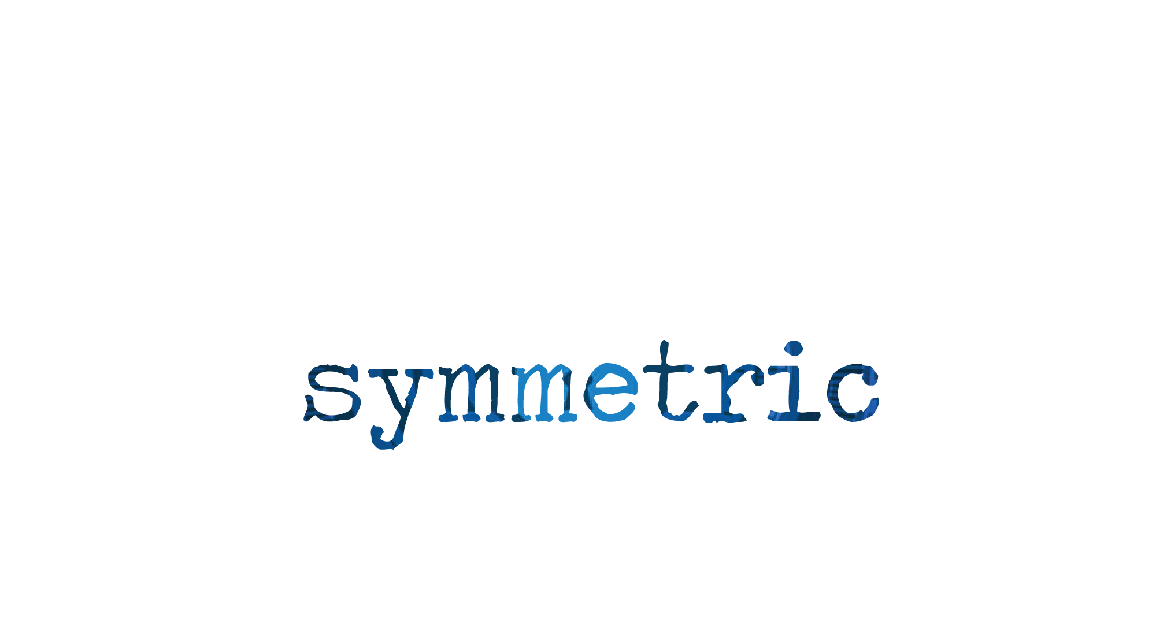
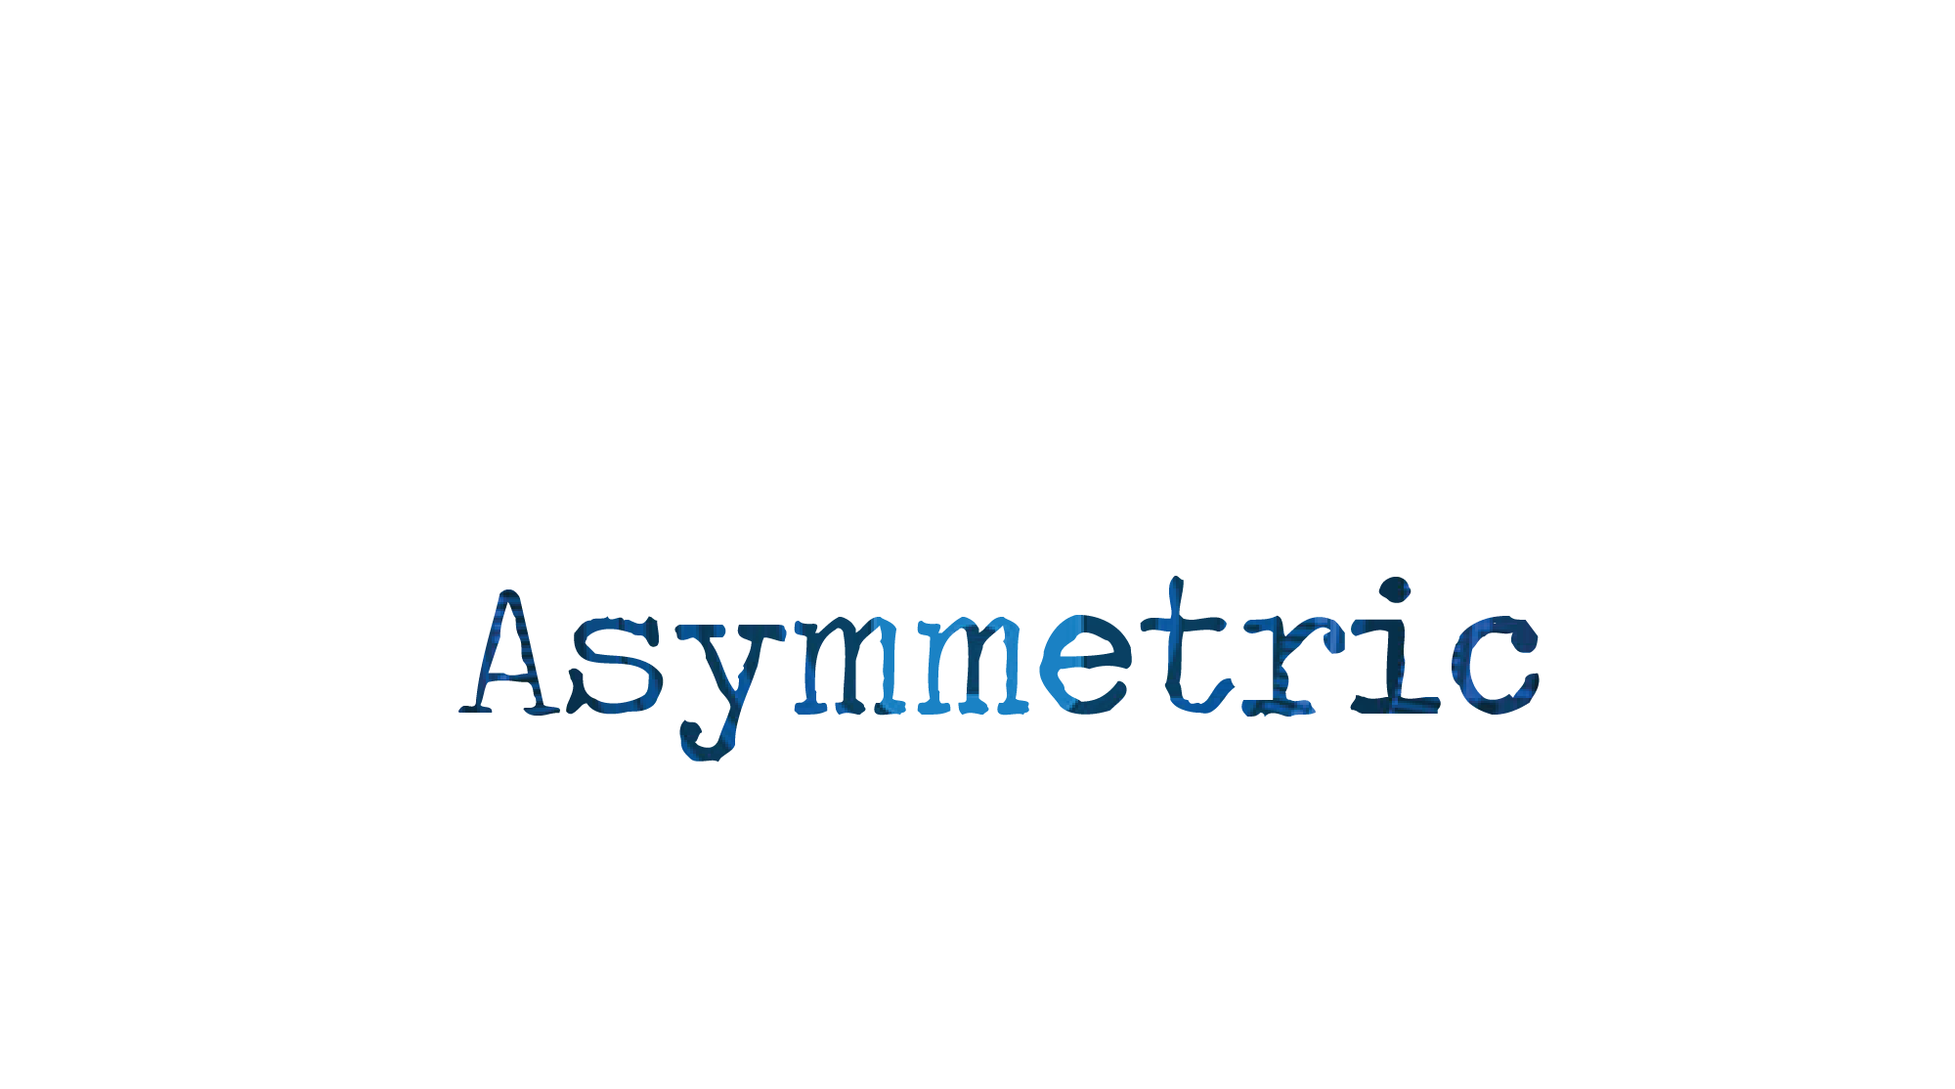

Slide 7

Ram
Hari

Slide 8
Passphrase: 8725
Ram
Hari

Slide 9

Ram
Hari
Passphrase: 8725

Slide 10
Ram
Hacker
Hari

Slide 11
1977
So
IN
Three
Geniuses

Slide 12
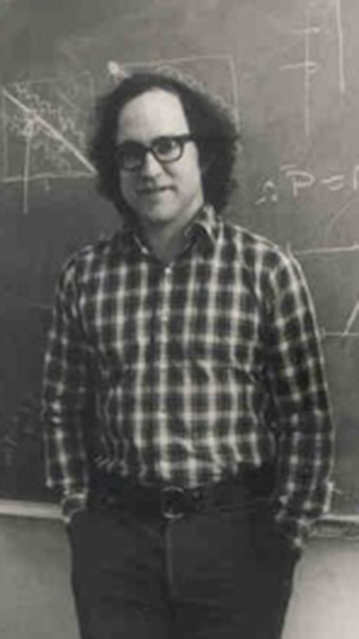

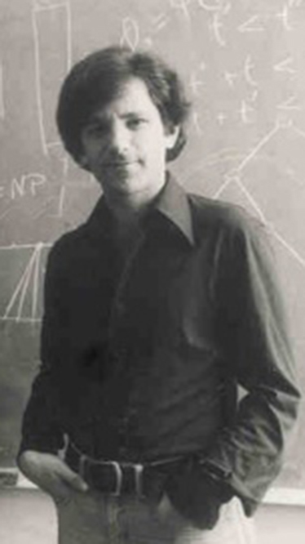
Geniuses
Ron Rivest
Adi Shamir
Leonard Aldeman

Slide 13
Asymmetric
Cryptographic
Algorithm

Slide 14
RSA

Slide 15
Asymmetric
Cryptographic
Algorithm

Slide 16


Asymmetric

Slide 17



Asymmetric

Slide 19


Slide 20



Slide 21


Slide 23
RSA
Private key
Public key

Slide 24
RSA
Private key
Public key

Slide 25
RSA
Private key
Public key

Slide 26
RSA
Private key
Private key
Public key
Public key

Slide 27
RSA
Ram
Hari
Public key
Public key
Private key
Private key

Slide 28
Key Generation
1. Select two large prime numbers
i.e. p and q
2. Multiply p and q
N = p * q

Slide 29
IN

Slide 30
IN
Past

Slide 31
IN
1977
Past

Slide 32
IN
years
Past
1977

Slide 33
IN
years
1977
Past
ago

Slide 34
45 * 16 = 720
96 * 56 = 4320
612 * 731 = 447372
731 * 981 = 717111
1241 * 434 = 538594
123 * 63 = 7749
245 * 76 = 18620
31642 * 46424 = 1468948208
1312 * 576 = 755712
132 * 165 = 21780
312 * 461 = 143832
31642 * 46424 = 1468948208
6134 * 1243 = 7624562
541 * 461 = 249401
431 * 464 = 199984

Slide 35
245 * 76 = 18620
245 * 76 = 18620
45 * 16 = 720
312 * 461 = 143832
731 * 981 = 717111
541 * 461 = 249401
431 * 464 = 199984
96 * 56 = 4320
123 * 63 = 7749
31642 * 46424 = 1468948208
1241 * 434 = 538594
13436 * 134646 = 1809103656
1312 * 576 = 755712
612 * 731 = 447372
132 * 165 = 21780
3436643268 * 2264631134646 = 7.782726852 x 10^21
31642 * 46424 = 1468948208
6134 * 1243 = 7624562

Slide 36
245 * 76 = 18620
1312 * 576 = 755712
45 * 16 = 720
96 * 56 = 4320
731 * 981 = 717111
1241 * 434 = 538594
31642 * 46424 = 1468948208
3436643268 * 2264631134646 = 7.782726852 x 10^21
612 * 731 = 447372
31642 * 46424 = 1468948208
431 * 464 = 199984
123 * 63 = 7749
541 * 461 = 249401
312 * 461 = 143832
132 * 165 = 21780
6134 * 1243 = 7624562

Slide 37
Prime Factorization
589
3 * xx
5 * xx
19 * 31 = 589
7 * xx
8 * xx
13 * xx

Slide 38

Prime Factorization
437000

Slide 39
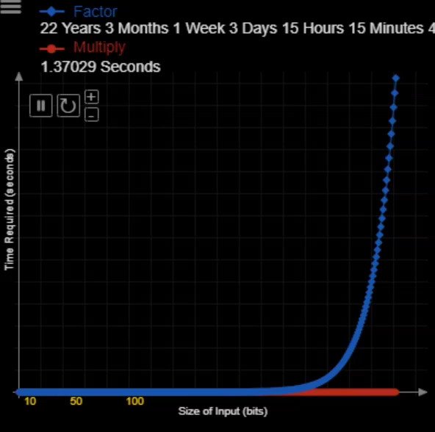
Prime Factorization
Time required
Size of input

Slide 40
Key Generation
1. Select two large prime numbers
i.e. p and q
2. Multiply p and q
N = p * q

Slide 41
Key Generation
1. Select two large prime numbers
i.e. p and q
2. Multiply p and q
N = p * q

Slide 42
Key Generation
1. Select two large prime numbers
i.e. p and q
2. Multiply p and q
N = p * q
3. Calculate phi of n
(n) = (p-1) * (q-1)

Slide 43
Euler’s totient function

Slide 44
Euler’s totient function
Leonardo Euler
totient
Function
Euler’s
is
as
the no
defined
Positive
integer
less
then
n
that
are
Co-prime
n
to

Slide 45
Euler’s totient function
Integer A = 7
Integer B = 3
7 = 1 x 7
3 = 1 x 3
gcd (Greatest common divisor) = 1

Slide 46
Euler’s totient function
(5) = (1, 2, 3, 4, 5)
(6) = (1, 2, 3, 4, 5, 6)

Slide 47
Euler’s totient function
-> 2
(3) = (1, 2, 3)
-> 5
(5) = (1, 2, 3, 4, 5)
(7) = (1, 2, 3, 4, 5, 6, 7)
-> 6
(11) = (1, 2, 3, 4, 5, 6, 7, 8, 9 ,10 ,11)
-> 10

Slide 48
Euler’s totient function
(n) = n-1

Slide 49
Euler’s totient function
# phi function is multiplicative
(A x B) = A B

Slide 50
Key Generation
1. Select two large prime numbers
i.e. p and q
2. Multiply p and q
N = p * q
3. Calculate phi of n
(n) = (p-1) * (q-1)

Slide 51
Key Generation
1. Select two large prime numbers
i.e. p and q
2. Multiply p and q
N = p * q
3. Calculate phi of n
(n) = (p-1) * (q-1)
4. Choose value for e
*Note : ’e’ should be greater than one smaller than phi n and gcd between e and phi n should be 1

Slide 52
Key Generation
1. Select two large prime numbers
i.e. p and q
2. Multiply p and q
N = p * q
3. Calculate phi of n
(n) = (p-1) * (q-1)
4. Choose value for e (Encryption)
5. Calculate value of d (decryption)

Slide 53
Euler's Theorem
-1
d = e mod (n)
Euler's theorem in term on phi
1 + k (n)
d =
e

Slide 54

Encryption
e
m mod n c
Where m is the message e, n are public key and c is encrypted message
Decryption
d
c mod n m
Where c is the cipher text d, n are private key and m is decrypted message

Slide 55
Key Generation
1. Two large prime numbers
p = 23 q = 29
2. Multiply p and q
N = p * q = 23 * 29 = 667
N = p * q = 23 * 29 = 667
3. Calculate phi of n
(667) = (23-1) * (29-1) = 616
4. Choose value for e (Encryption)
e = 3
e = 3
5. Calculate value of d (decryption)

Slide 56
Key Generation
5. Calculate value of d (decryption)
1 + k (n)
d =
e
1 + 2 x 616
d =
= 413
3

Slide 57
Shyam
Message = ‘Hi’ = 57
Ram
Hari
public key = (e , n) = (3, 667)
public key = (e , n) = (3, 667)
public key = (e , n) = (3, 667)
private key = (d , n) = (411, 667)

Slide 58
public key = (e , n) = (3, 667)
Shyam
Message = ‘Hi’ = 57
Ram
Hari
public key = (e , n) = (3, 667)
public key = (e , n) = (3, 667)
private key = (d , n) = (411, 667)

Slide 59
public key = (e , n) = (3, 667)
Shyam
Message = ‘Hi’ = 57
Ram
Hari
public key = (e , n) = (3, 667)
public key = (e , n) = (3, 667)
private key = (d , n) = (411, 667)
Encryption
3
57 mod 667 434
434
434

Slide 60
public key = (e , n) = (3, 667)
434
Shyam
Message = ‘Hi’ = 57
Ram
Hari
public key = (e , n) = (3, 667)
public key = (e , n) = (3, 667)
private key = (d , n) = (411, 667)
Encryption
434
3
57 mod 667 434

Slide 61
public key = (e , n) = (3, 667)
434
public key = (e , n) = (3, 667)
Shyam
Message = ‘Hi’ = 57
Ram
Hari
public key = (e , n) = (3, 667)
private key = (d , n) = (411, 667)
434
Decryption
411
434 mod 667 57

